Slide 1
Chemistry – Dec 2, 2019
Get out #5 and 6 problems for HMK check.
Turn in your Beanium Lab if not yet.
P3 Challenge-
  Find the average atomic mass of chlorine give that it has 2 isotopes: Cl-35 and Cl-37.
  ³⁵Cl 34.968853 75.78%
  ³⁷Cl 36.965903 24.22 %
Objective –
  Nuclear Chemistry
Agenda
  Types of Radiation
  Radioactive decay
  Nuclear Reactions
  Half-life
Assignment: Nuclear Chemistry Worksheet

Slide 2
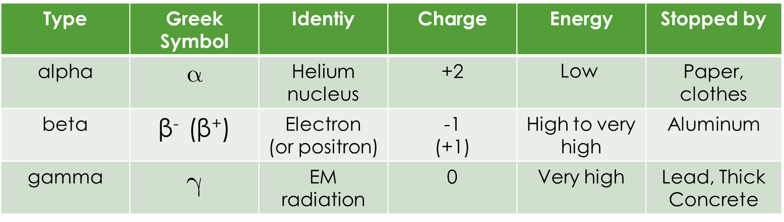
Nuclear Radiation
Radioactivity – spontaneous emission of nuclear radiation from a nucleus
  Term first coined by Marie Curie
Three types of nuclear radiation
Type | Greek Symbol | Identiy | Charge | Energy | Stopped by
alpha |  | Helium nucleus | +2 | $$\text{Low}$$ | Paper, clothes
beta | β⁻ (β⁺) | Electron (or positron) | -1 (+1) | High to very high | Aluminum
gamma |  | EM radiation | 0 | Very high | Lead, Thick Concrete

Slide 3


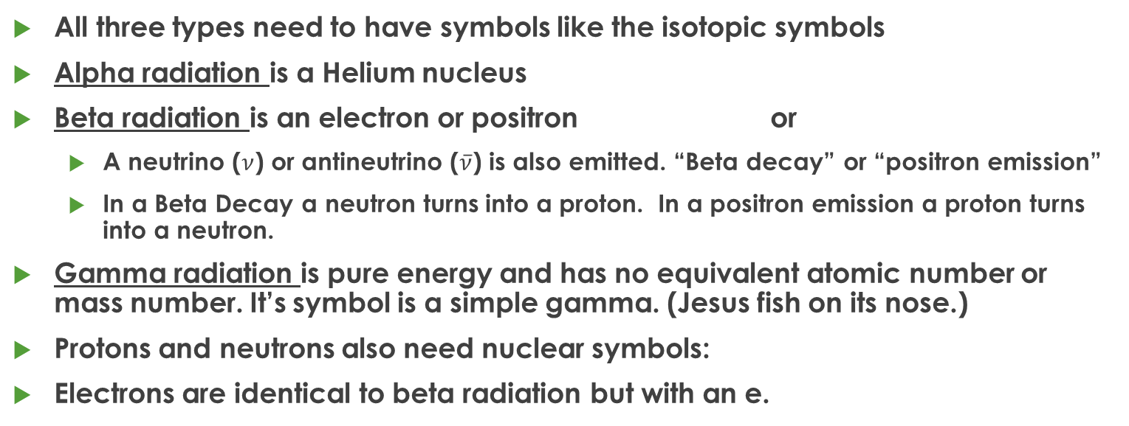


Nuclear Reaction Symbols
All three types need to have symbols like the isotopic symbols
Alpha radiation is a Helium nucleus
Beta radiation is an electron or positron or
  A neutrino ($ν$) or antineutrino ($\overline{ν}$) is also emitted. “Beta decay” or “positron emission”
  In a Beta Decay a neutron turns into a proton. In a positron emission a proton turns into a neutron.
Gamma radiation is pure energy and has no equivalent atomic number or mass number. It’s symbol is a simple gamma. (Jesus fish on its nose.)
Protons and neutrons also need nuclear symbols:
Electrons are identical to beta radiation but with an e.
$${}_{−1}^{0}{β+\overline{ν}}$$
$${}_{+1}^{0}β+ν$$
$${}_{0}^{0}γ$$
$${}_{−1}^{0}{\text{e}}$$

Slide 4
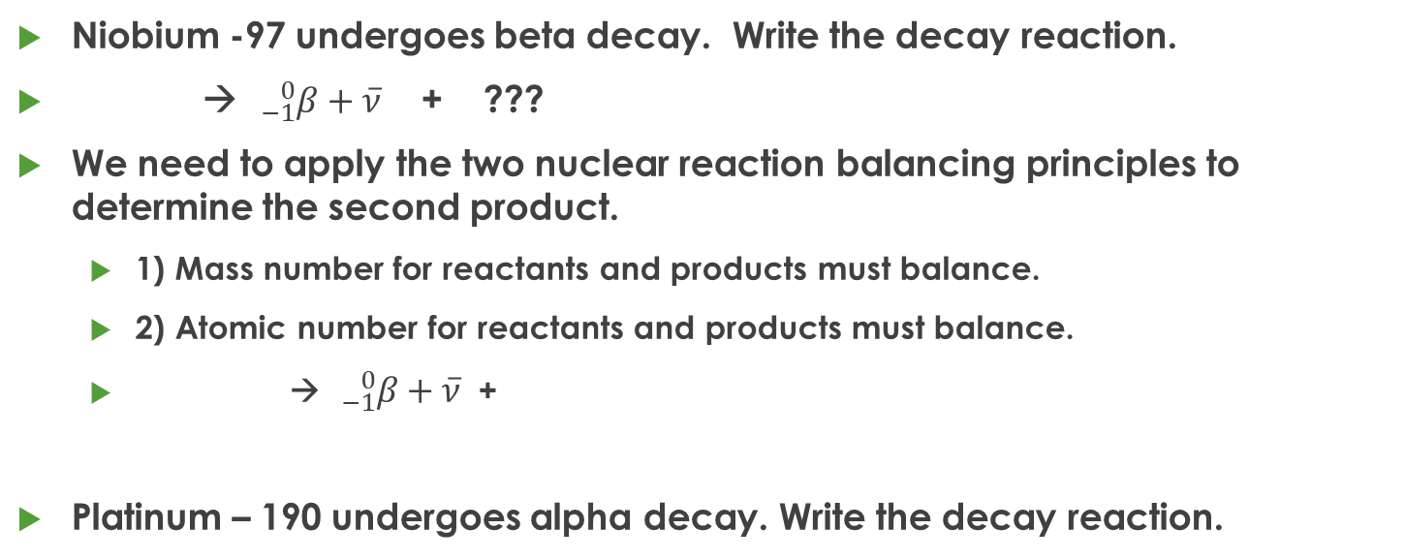
Reactions for nuclear decay
Niobium -97 undergoes beta decay. Write the decay reaction.
→ ${}_{−1}^{0}{β+\overline{ν}}$ + ???
We need to apply the two nuclear reaction balancing principles to determine the second product.
  1) Mass number for reactants and products must balance.
  2) Atomic number for reactants and products must balance.
  → ${}_{−1}^{0}{β+\overline{ν}}$+
Platinum – 190 undergoes alpha decay. Write the decay reaction.

Slide 5
Practice
Uranium – 238 undergoes alpha decay.
Thorium – 238 undergoes beta decay.

Slide 6
Other Nuclear Reactions
Besides natural decay, nuclear reactions can be induced by colliding small particles like neutrons or protons into a nuclide.
Ex: When aluminum – 27 is hit with an alpha particle, a neutron and a second nuclide is produced.
Practice: When cobalt – 59 is bombarded with a neutron, an alpha particle is released and a new nuclide is produced.

Slide 7
Half-life
The half-life information on the table of nuclides tells how fast a sample of that isotope will decay.
The half-life is the length of time required for half of the sample to decay.
For a 1 g sample, after one half-life, 0.500 g remain.
After two half-life, the 0.500 g left after the first half-life gets cut in half again: 0.250 g remain.
After 3 half-lives, 0.125 g are left, or 1/8 gram.
After 4 half-lives, 1/16 gram is left.
After 5 half-lives, 1/32 gram is left….etc…

Slide 8
Exit Slip
Exit slip – ¹¹²Ag undergoes a beta decay
What’s Due? (Pending assignments to complete.)
  Nuclear Chemistry Problems Worksheet
What’s Next? (How to prepare for the next day)
  Read Holt p648-657

